Slide 1

Title Slide
Title: Machine Learning-Based Control System Simulation for In-Situ Monitoring of Additive Manufacturing Process.
Subtitle: Enhancing Quality and Efficiency of Direct Energy Deposition Process.
Name: Aditya Manoj Madgulkar
Guide: Dr. Gopinath Muvvala

Slide 2
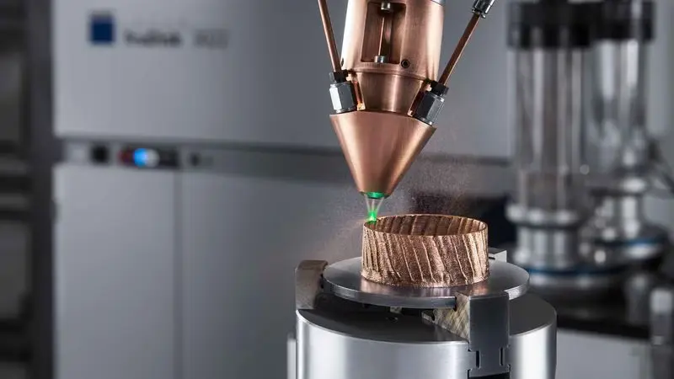
Introduction to Direct Energy Deposition (DED)
Direct Energy Deposition (DED) is an additive manufacturing process that melts and deposits material layer by layer using a laser or electron beam.
Our system uses a fiber laser (ytterbium) for precise material deposition and solidification.
The cooling rate of the deposited material affects the final part's microstructure and mechanical properties.
FIG 1: Direct Energy Deposition

Slide 3
Importance of Cooling Rate in DED
Features | Cooling rate increase | Cooling rate decrease
Microstructure formation | Finer grains, potential segregation | Larger grains, improved homogeneity
Residual stress management | Higher stresses, higher risk of distortion and cracking | Lower stresses, reduced risk of distortion and cracking
Phase transformation control | Harder phases, higher strength, lower toughness | Softer phases, lower strength, higher ductility
Surface finish | Coarser finish, possible defects | Finer finish, reduced defects
Material consistency | Variable material properties | Consistent material properties
Process optimization | Needs advanced control | Simpler to manage

Slide 4
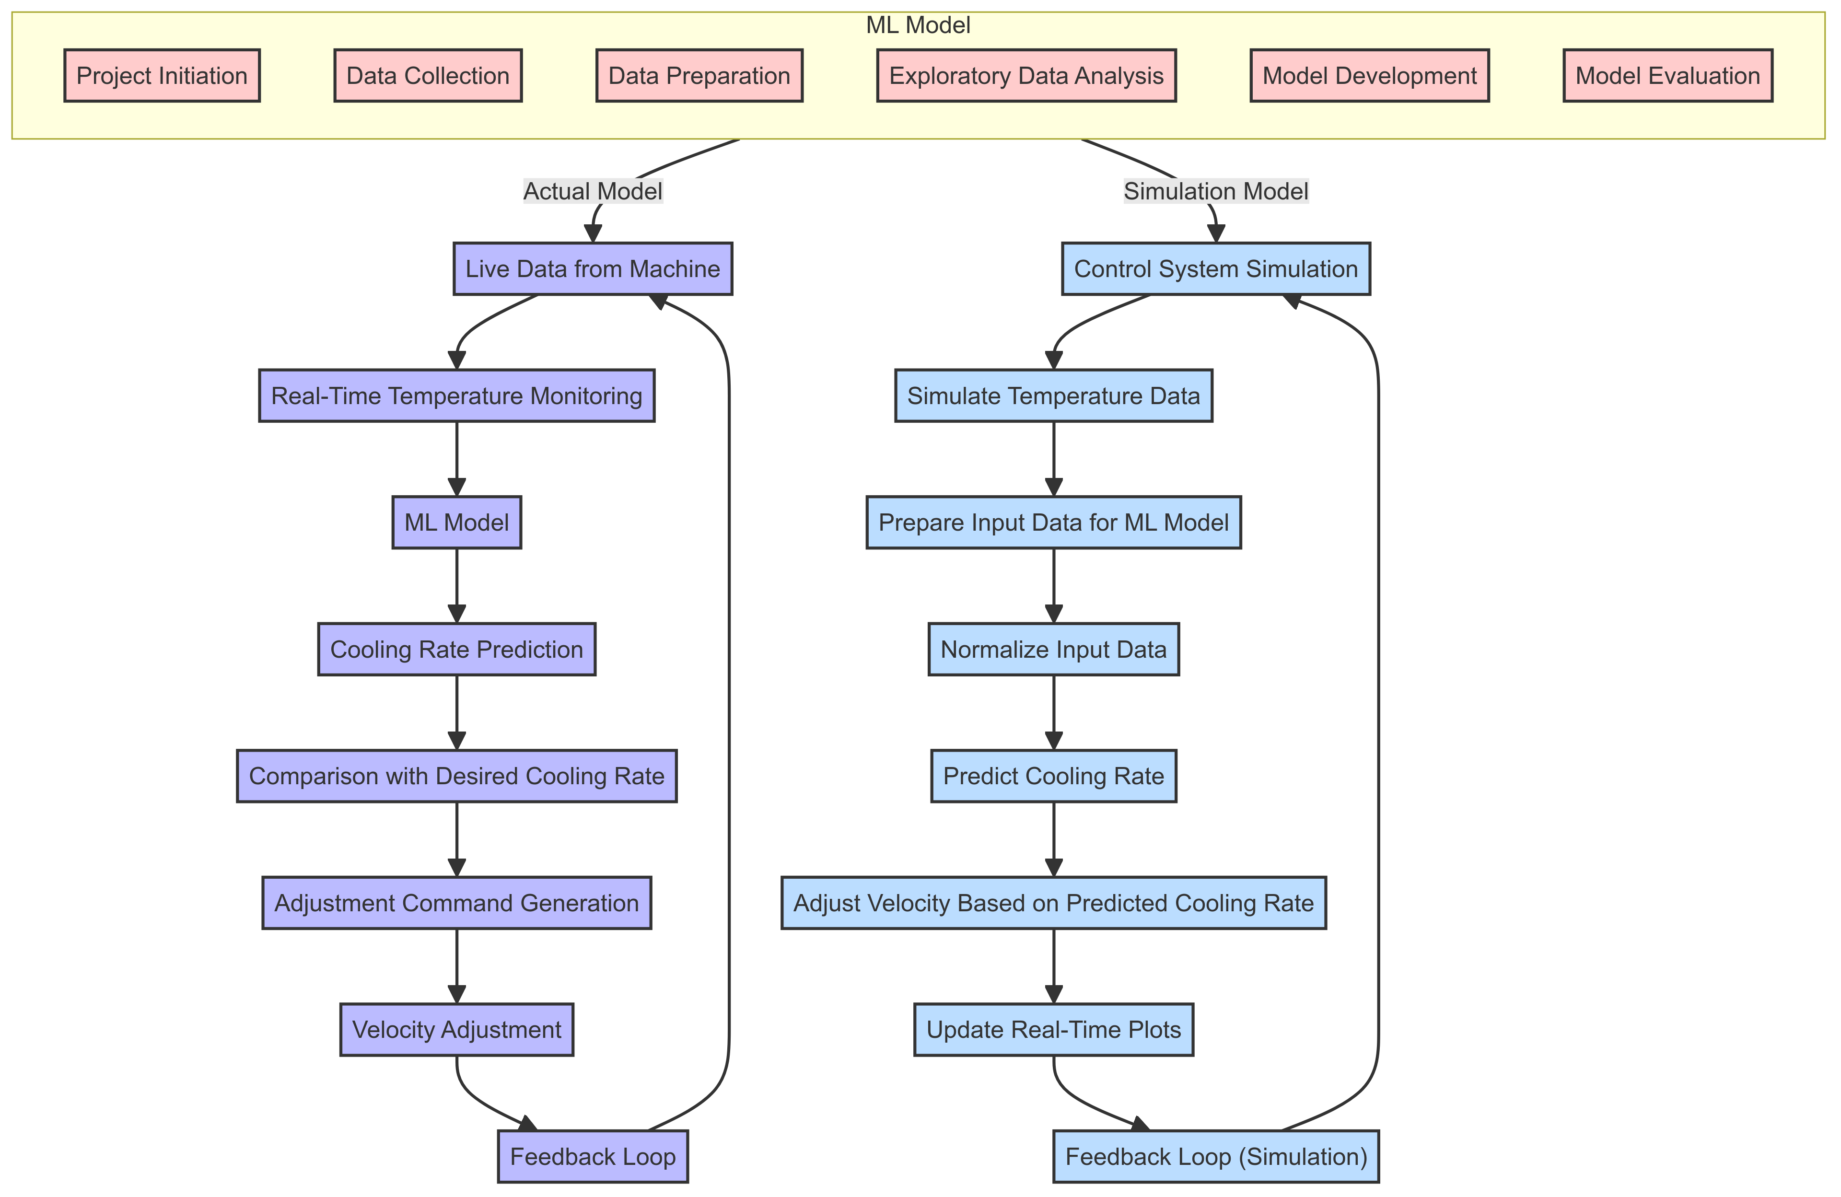
Project Overview
FIG 2: Flow Chart for Project Overview

Slide 5
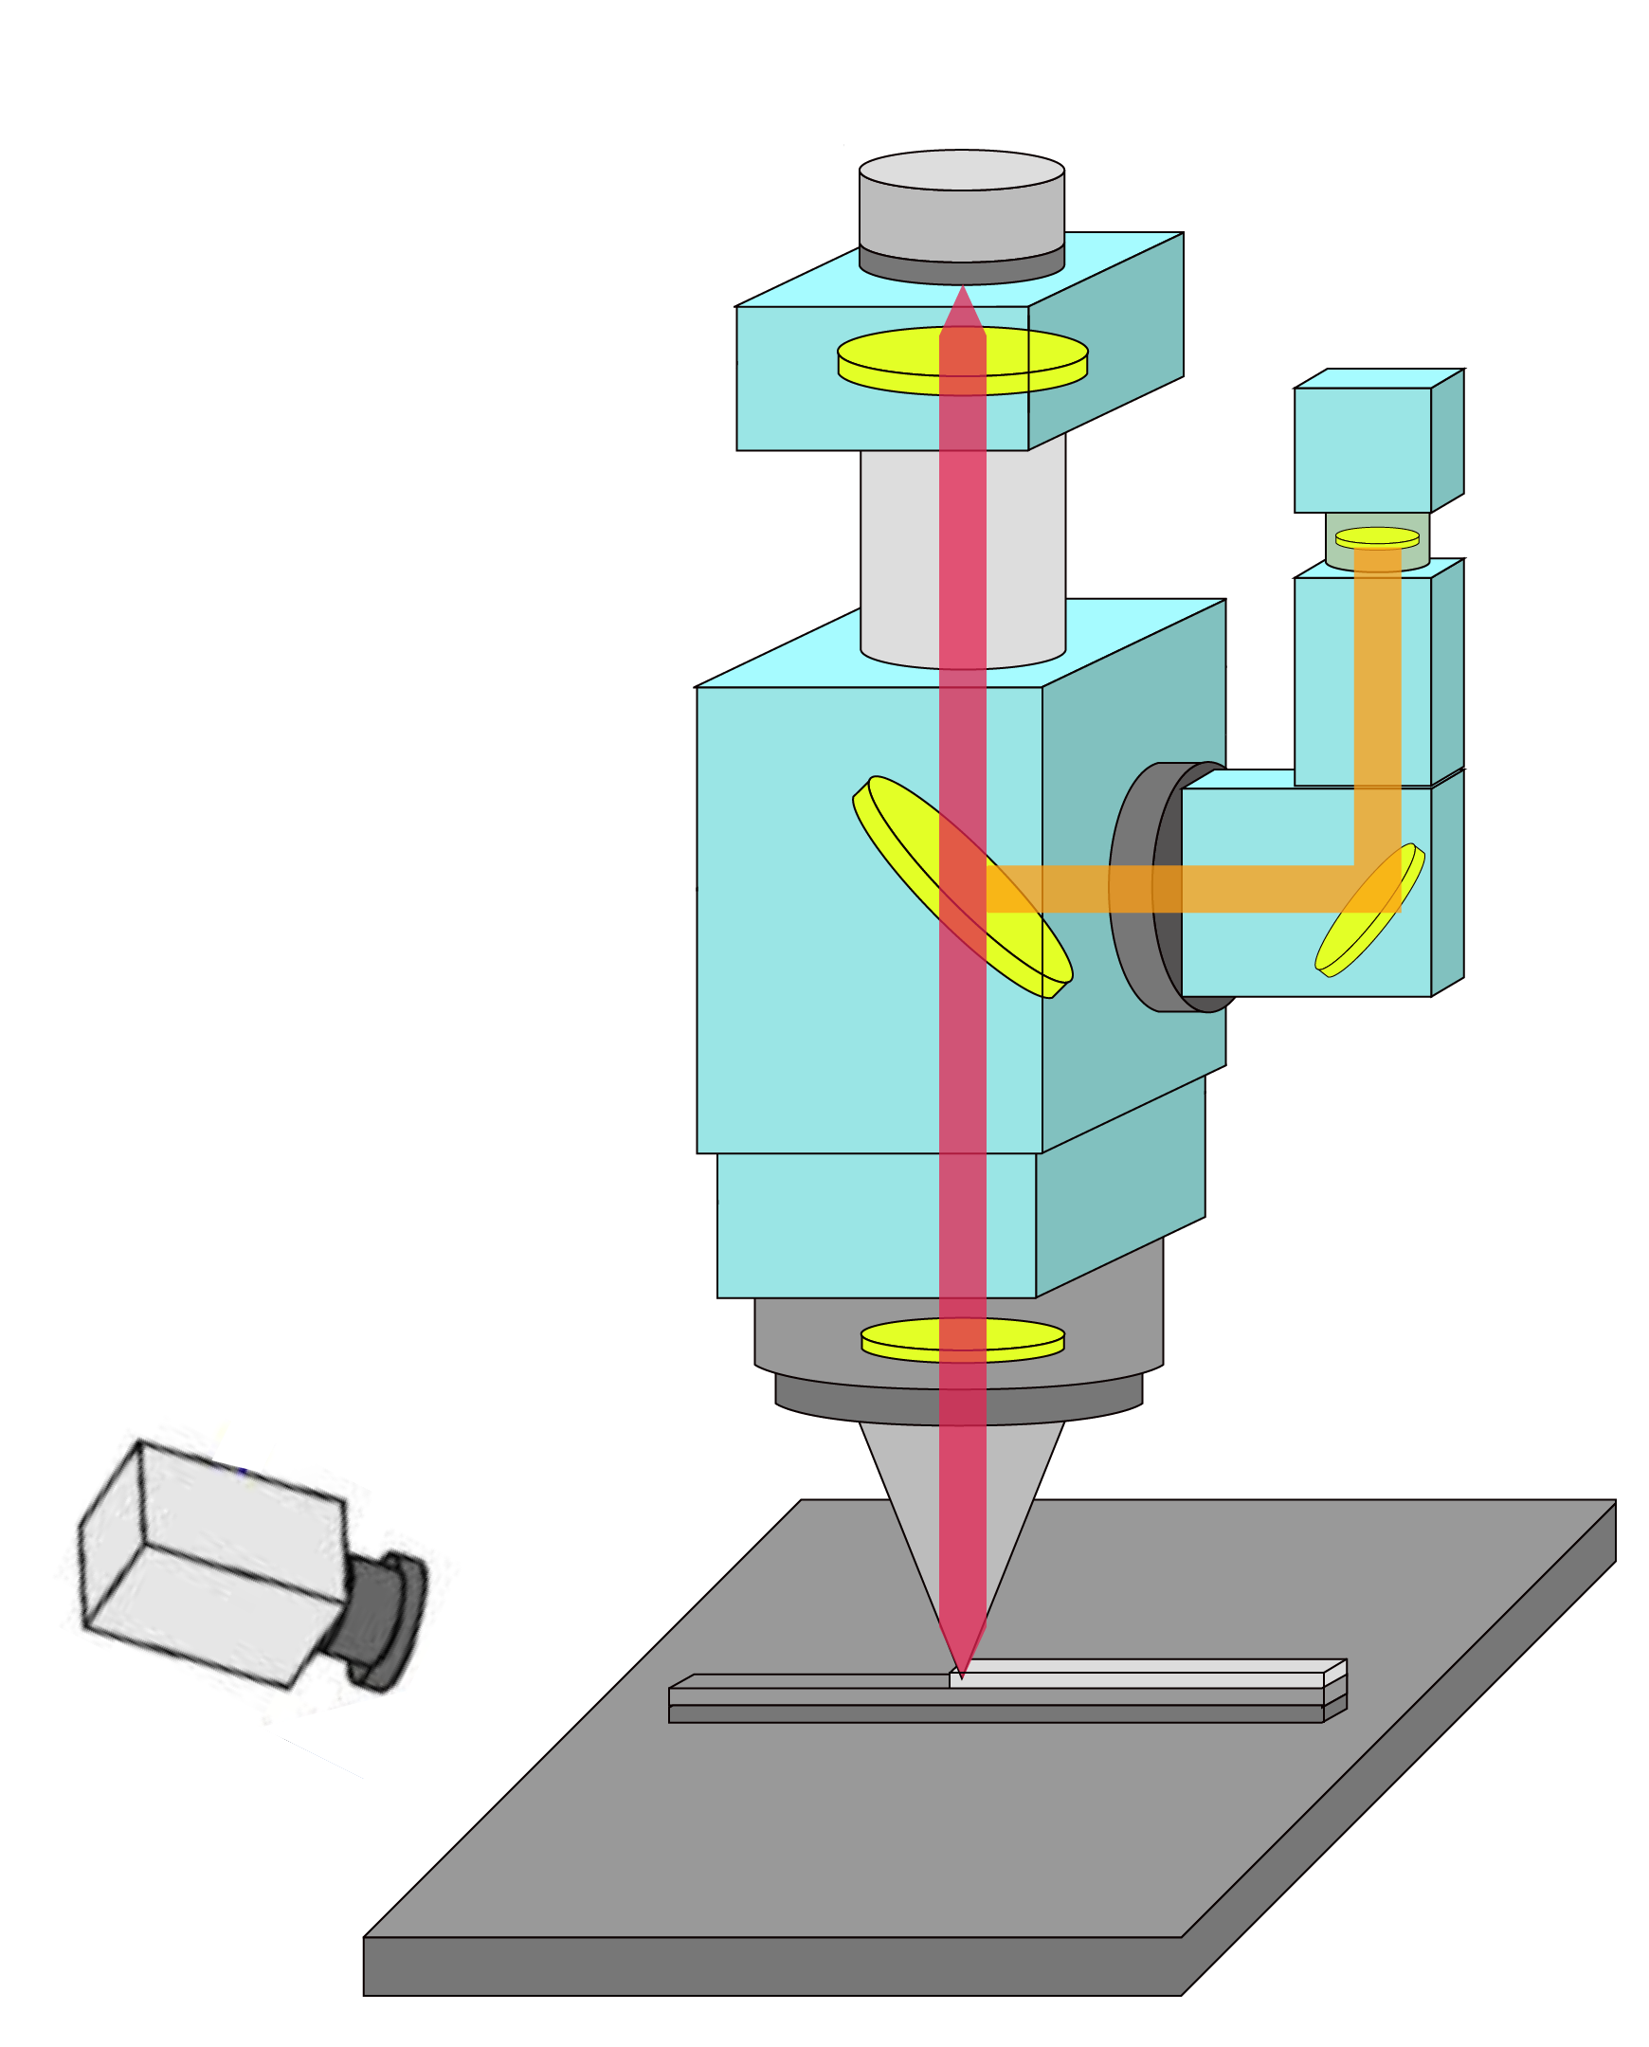






Schematic of Process Monitoring of DED
Coaxial Camera
Monitoring
system
Focusing Lens
(Plano-convex lens)
Shielding Gas
Laser beam
Carrier Gas
Guiding Lens
Pyrometer 1
Powder Feeder
T1
Protective Lens
T2
Pyrometer 2
10RPM
15L/min
10RPM
15L/min
Deposited
Layers
7mm Offset
Argon Gas Cylinder
Substrate
Motion of the Substrate
FIG 3: Schematic of Process Monitoring of DED

Slide 6
Data Collection
Temperature readings:
T1 (molten pool):
T1 is measured at the molten pool using a precise pyrometer.
T2 (7mm away):
T2 is measured 7mm away from the molten pool using a precise pyrometer.
Velocities: -
Data Collected at Different Velocities: -
600 mm/min - 800 mm/min - 1000 mm/min - 1200 mm/min.
Experimental setup: -
Substrate: Mild Steel.
Material: Nickel Chromium Tungsten Carbide Powder.
Deposition: 90mm Distance Thin Wall.

Slide 7
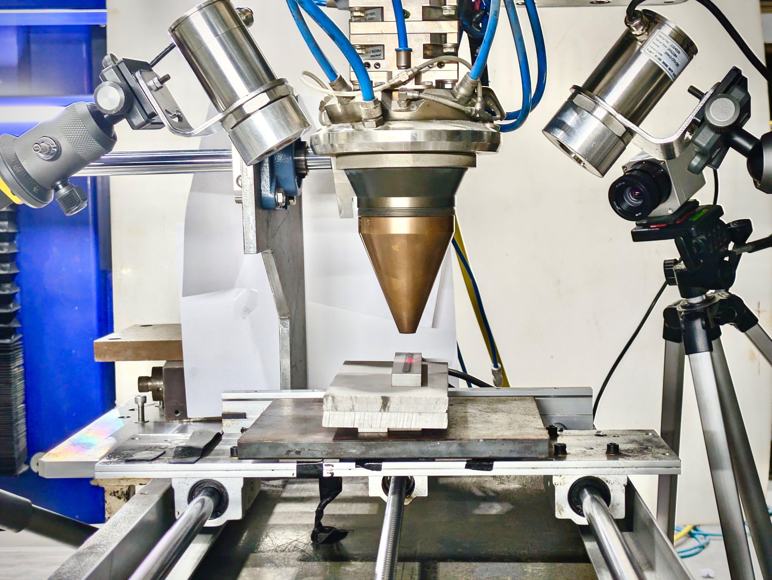
Actual Image of Process Monitoring of DED
Pyrometer 2
Pyrometer 1
Thermal Camera
Co-axial Nozzle
Deposited
Layers
Substrate
Sliding Bed
FIG 4: Actual Image of Process Monitoring of DED

Slide 8
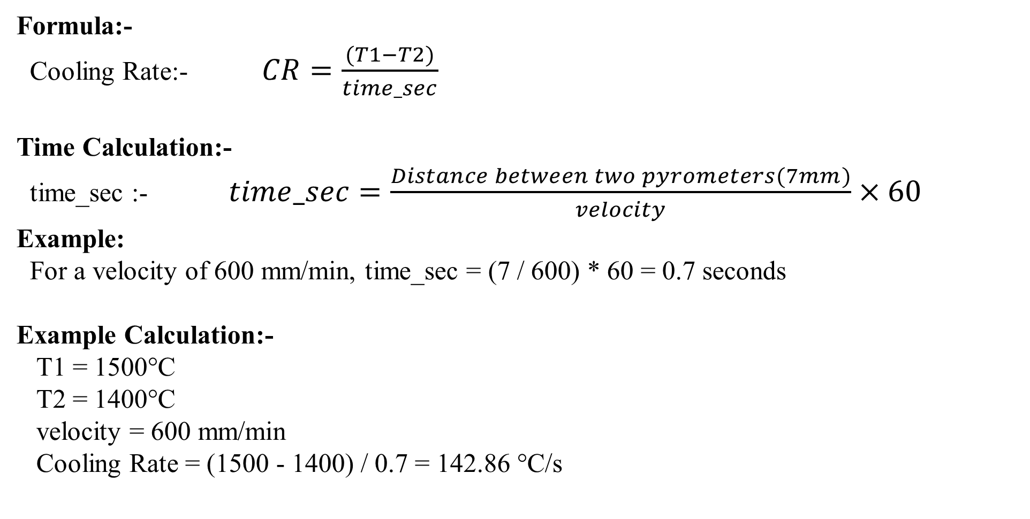
Calculation of Cooling Rate
Formula:-
Cooling Rate:- $CR=\frac{(T1−T2)}{time_sec}$
Time Calculation:-
time_sec :- $time_sec=\frac{Distance between two pyrometers(7mm)}{velocity}×60$
Example:
For a velocity of 600 mm/min, time_sec = (7 / 600) * 60 = 0.7 seconds
Example Calculation:-
T1 = 1500°C
T2 = 1400°C
velocity = 600 mm/min
Cooling Rate = (1500 - 1400) / 0.7 = 142.86 °C/s

Slide 9
Schematic of Process Monitoring of DED
Coaxial Camera
Monitoring
system
Focusing Lens
(Plano-convex lens)
Shielding Gas
Laser beam
Carrier Gas
Guiding Lens
Pyrometer 1
Powder Feeder
T1
Protective Lens
T2
Pyrometer 2
10RPM
15L/min
10RPM
15L/min
Deposited
Layers
Thermal Camera
7mm Offset
Argon Gas Cylinder
Substrate
Motion of the Substrate
FIG 3: Schematic of Process Monitoring of DED

Slide 10
WC Cladding- Pyrometer Distance Calibration- 3mm, 5mm, 7mm

Slide 11
Without-Post Heat at 7 mm Distance from Melt pool

Slide 12
Without-Post Heat at 7 mm Distance from Melt pool

Slide 13
Data Preparation
Historic Data:-
This Data Refers To Previously Collected Data That Is Used To Train Models.
This Data Includes Input Features And Corresponding Outcomes Or Labels From Past Events Or Observations.
Operations On Historic Data:-
Data Cleaning: Handling Missing Value, Removing Columns Not Relevant To Task.
Separate Features And Labels: Extract Input Variables And Target Variable.
Normalize The Features: Scale Features To A Consistent Range.
Replace Original Features With Scaled Features: Update Dataset With Normalized Features

Slide 14

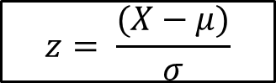
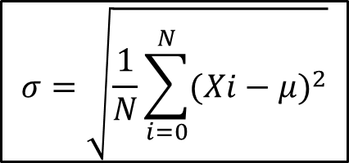
Data Normalizing
Mean (μ): Average of values.
$$μ=\frac{1}{N}\sum_{i=0}^{N}{Xi}$$
Standard Deviation (σ): Measures spread of values.
$$σ=\sqrt{\frac{1}{N}\sum_{i=0}^{N}{({Xi−μ)}^{2}}}$$
Standardization (Z-score Normalization): Transforms data to have a mean of 0 and a standard deviation of 1.
$$z= \frac{(X−μ)}{σ}$$

Slide 15
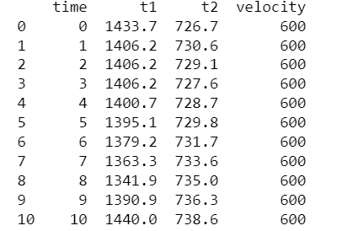
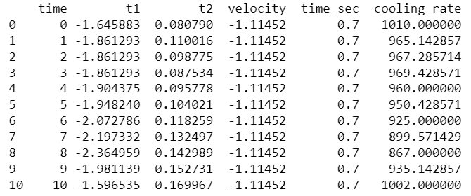
Transformation of Historic Data
Normalization transforms historic data to a uniform scale, making it easier to analyze and model effectively.
FIG 5: Original Data
FIG 6: Standardized Data

Slide 16
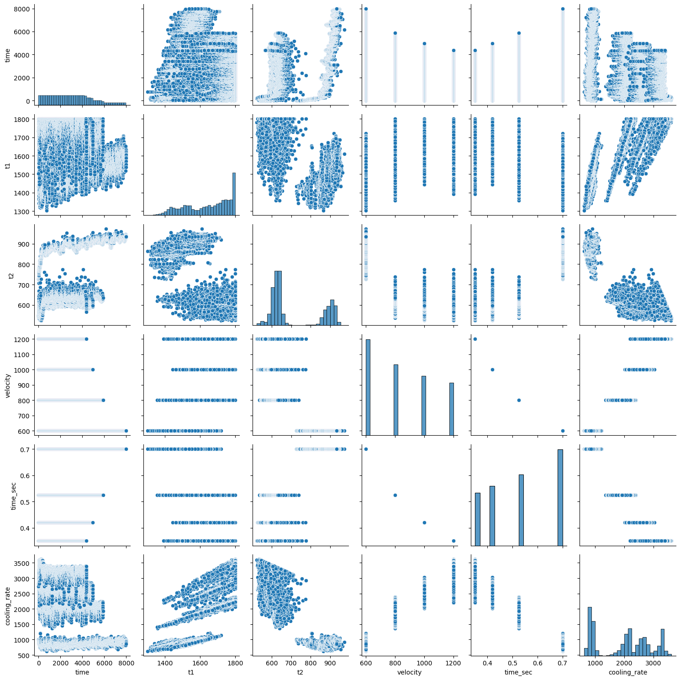
Exploratory Data Analysis
FIG 7: Exploratory Data Analysis Visualization

Slide 17
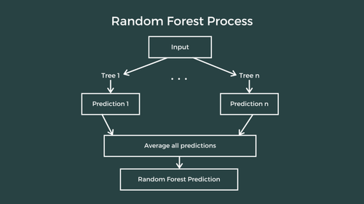
Machine Learning Model
Random Forest Regression:-
It is a supervised learning model that predicts continuous values by averaging the results from multiple decision trees.
This method helps to improve accuracy and reduces the risk of overfitting.
It’s good for handling diverse and complex data.
FIG 7: Random Forest Regression

Slide 18
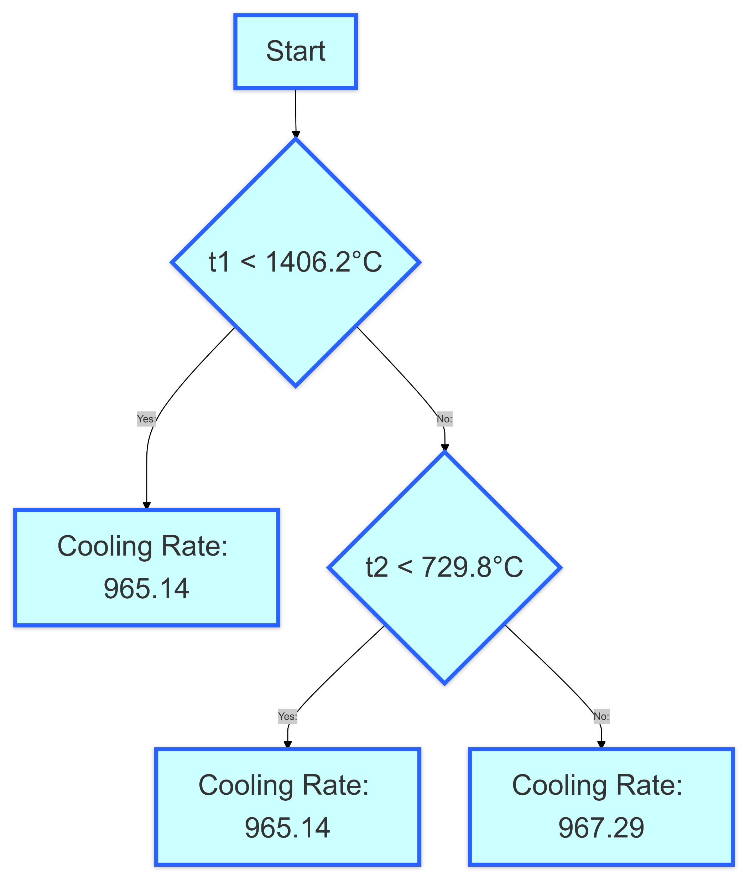
Decision Tree
How It Works:
Decision Tree:
A model that splits data into decisions based on feature values.
Create Multiple Trees:
Builds many decision trees using different data samples.
Combine Results:
Averages the predictions from all trees for
the final result.
Root Node
Yes
No
Branch Node
Leaf Node
Yes
No
FIG 8: Decision Tree

Slide 19
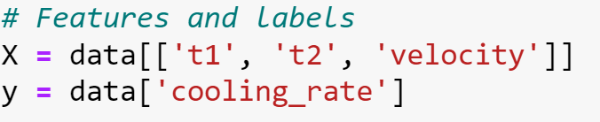
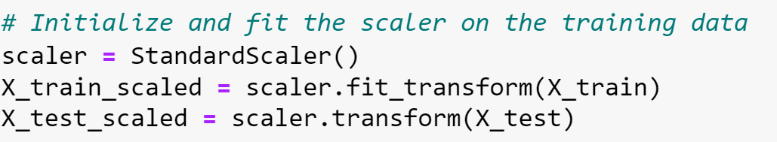
Model Development
1. Data Preparation
Features (X): t1, t2, velocity, Label (y): cooling_rate
2. Train-Test Split
Splitting data into training (80%) and testing (20%) sets.
3. Data Scaling
Standardizing features to have mean 0 and variance 1.

Slide 20
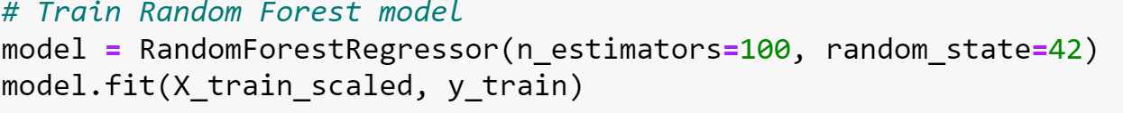
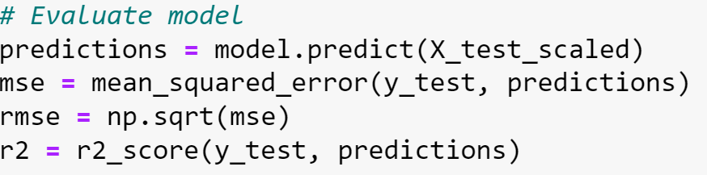
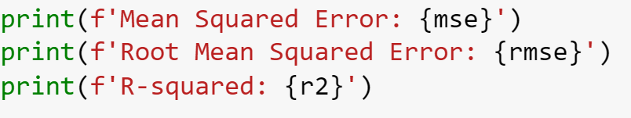
Model Development
4. Model Training
Algorithm: Random Forest Regressor, Parameters: 100 trees, random state 42
5. Model Evaluation
Metrics: Mean Squared Error (MSE), Root Mean Squared Error (RMSE), R-squared (R²)
6. Results
MSE: {mse}, RMSE: {rmse}, R²: {r2}

Slide 21
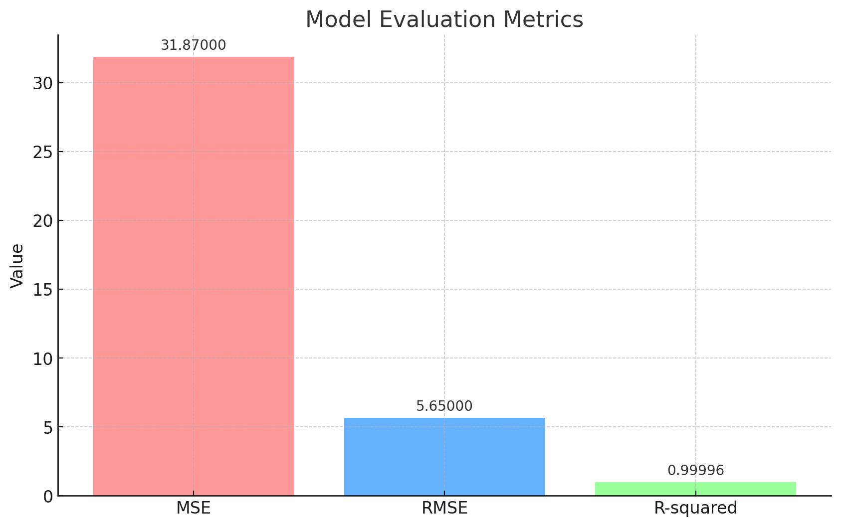
Model Evaluation
FIG 9: Model Evaluation

Slide 22
Simulation Model: Temperature Data Generation
Controlled Environment: Simulation generates temperature values (t1 and t2) for precise
analysis in a controlled setting.
Flexible Testing: Allows for experimentation and scenario testing without the constraints
of real-world data.
Risk-Free Optimization: Provides a safe platform to evaluate and refine control
strategies before real-world application.
Cost-Effective Development: Minimizes the need for expensive physical prototypes by
enabling virtual design optimization.

Slide 23
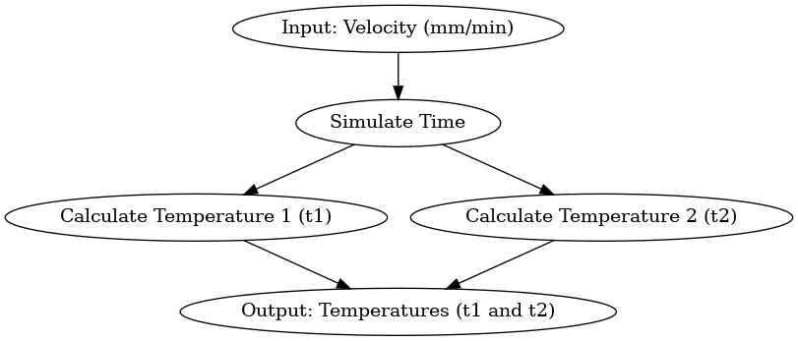
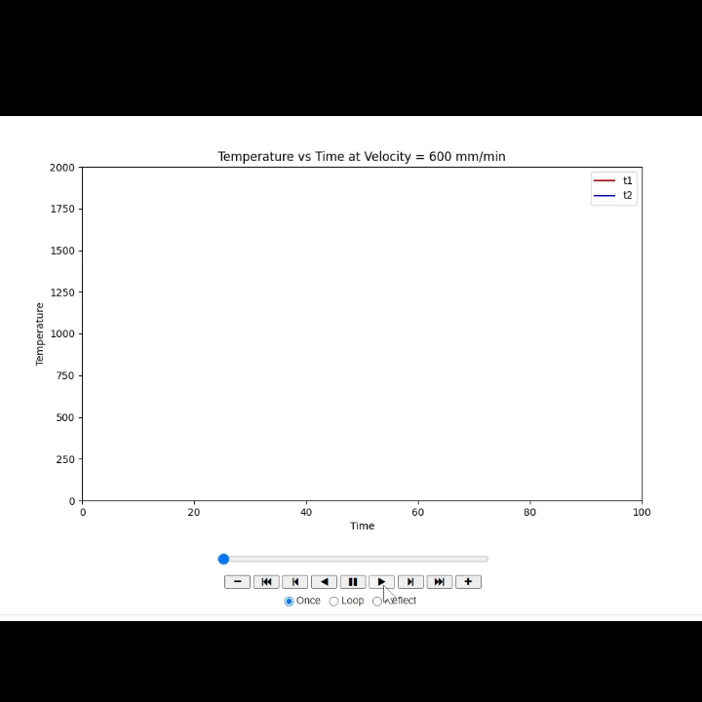
Simulation Model Development
FIG 10:T1 & T2 WorkFlow
FIG 11:T1 & ST2 Temperature

Slide 24
Simulation Model Development

Slide 25
Simulation Model Development

Slide 26
Simulation Model Development

Slide 27
Simulation Model Development

Slide 28
Simulation Model Development

Slide 29
Simulation Model Development

Slide 30
References
In-situ Process Monitoring and Adaptive Quality Enhancement in Laser Additive Manufacturing: A Critical Review:-
In-situ process monitoring and adaptive quality enhancement in laser additive manufacturing: A critical review – ScienceDirect
Statistical Parameterized Physics-Based Machine Learning Digital Twin Models for Laser Powder Bed Fusion Process:- http://arxiv.org/pdf/2311.07821v1
An Ontology for Defect Detection in Metal Additive Manufacturing:-
An Ontology for Defect Detection in Metal Additive Manufacturing (researchgate.net)
In-situ Process Monitoring and Adaptive Quality Enhancement in Laser Additive Manufacturing: A Critical Review:-
http://arxiv.org/pdf/2404.13673v1
In-situ monitoring additive manufacturing process with AI edge computing:-
In-situ monitoring additive manufacturing process with AI edge computing - ScienceDirect

Slide 31


Slide 32
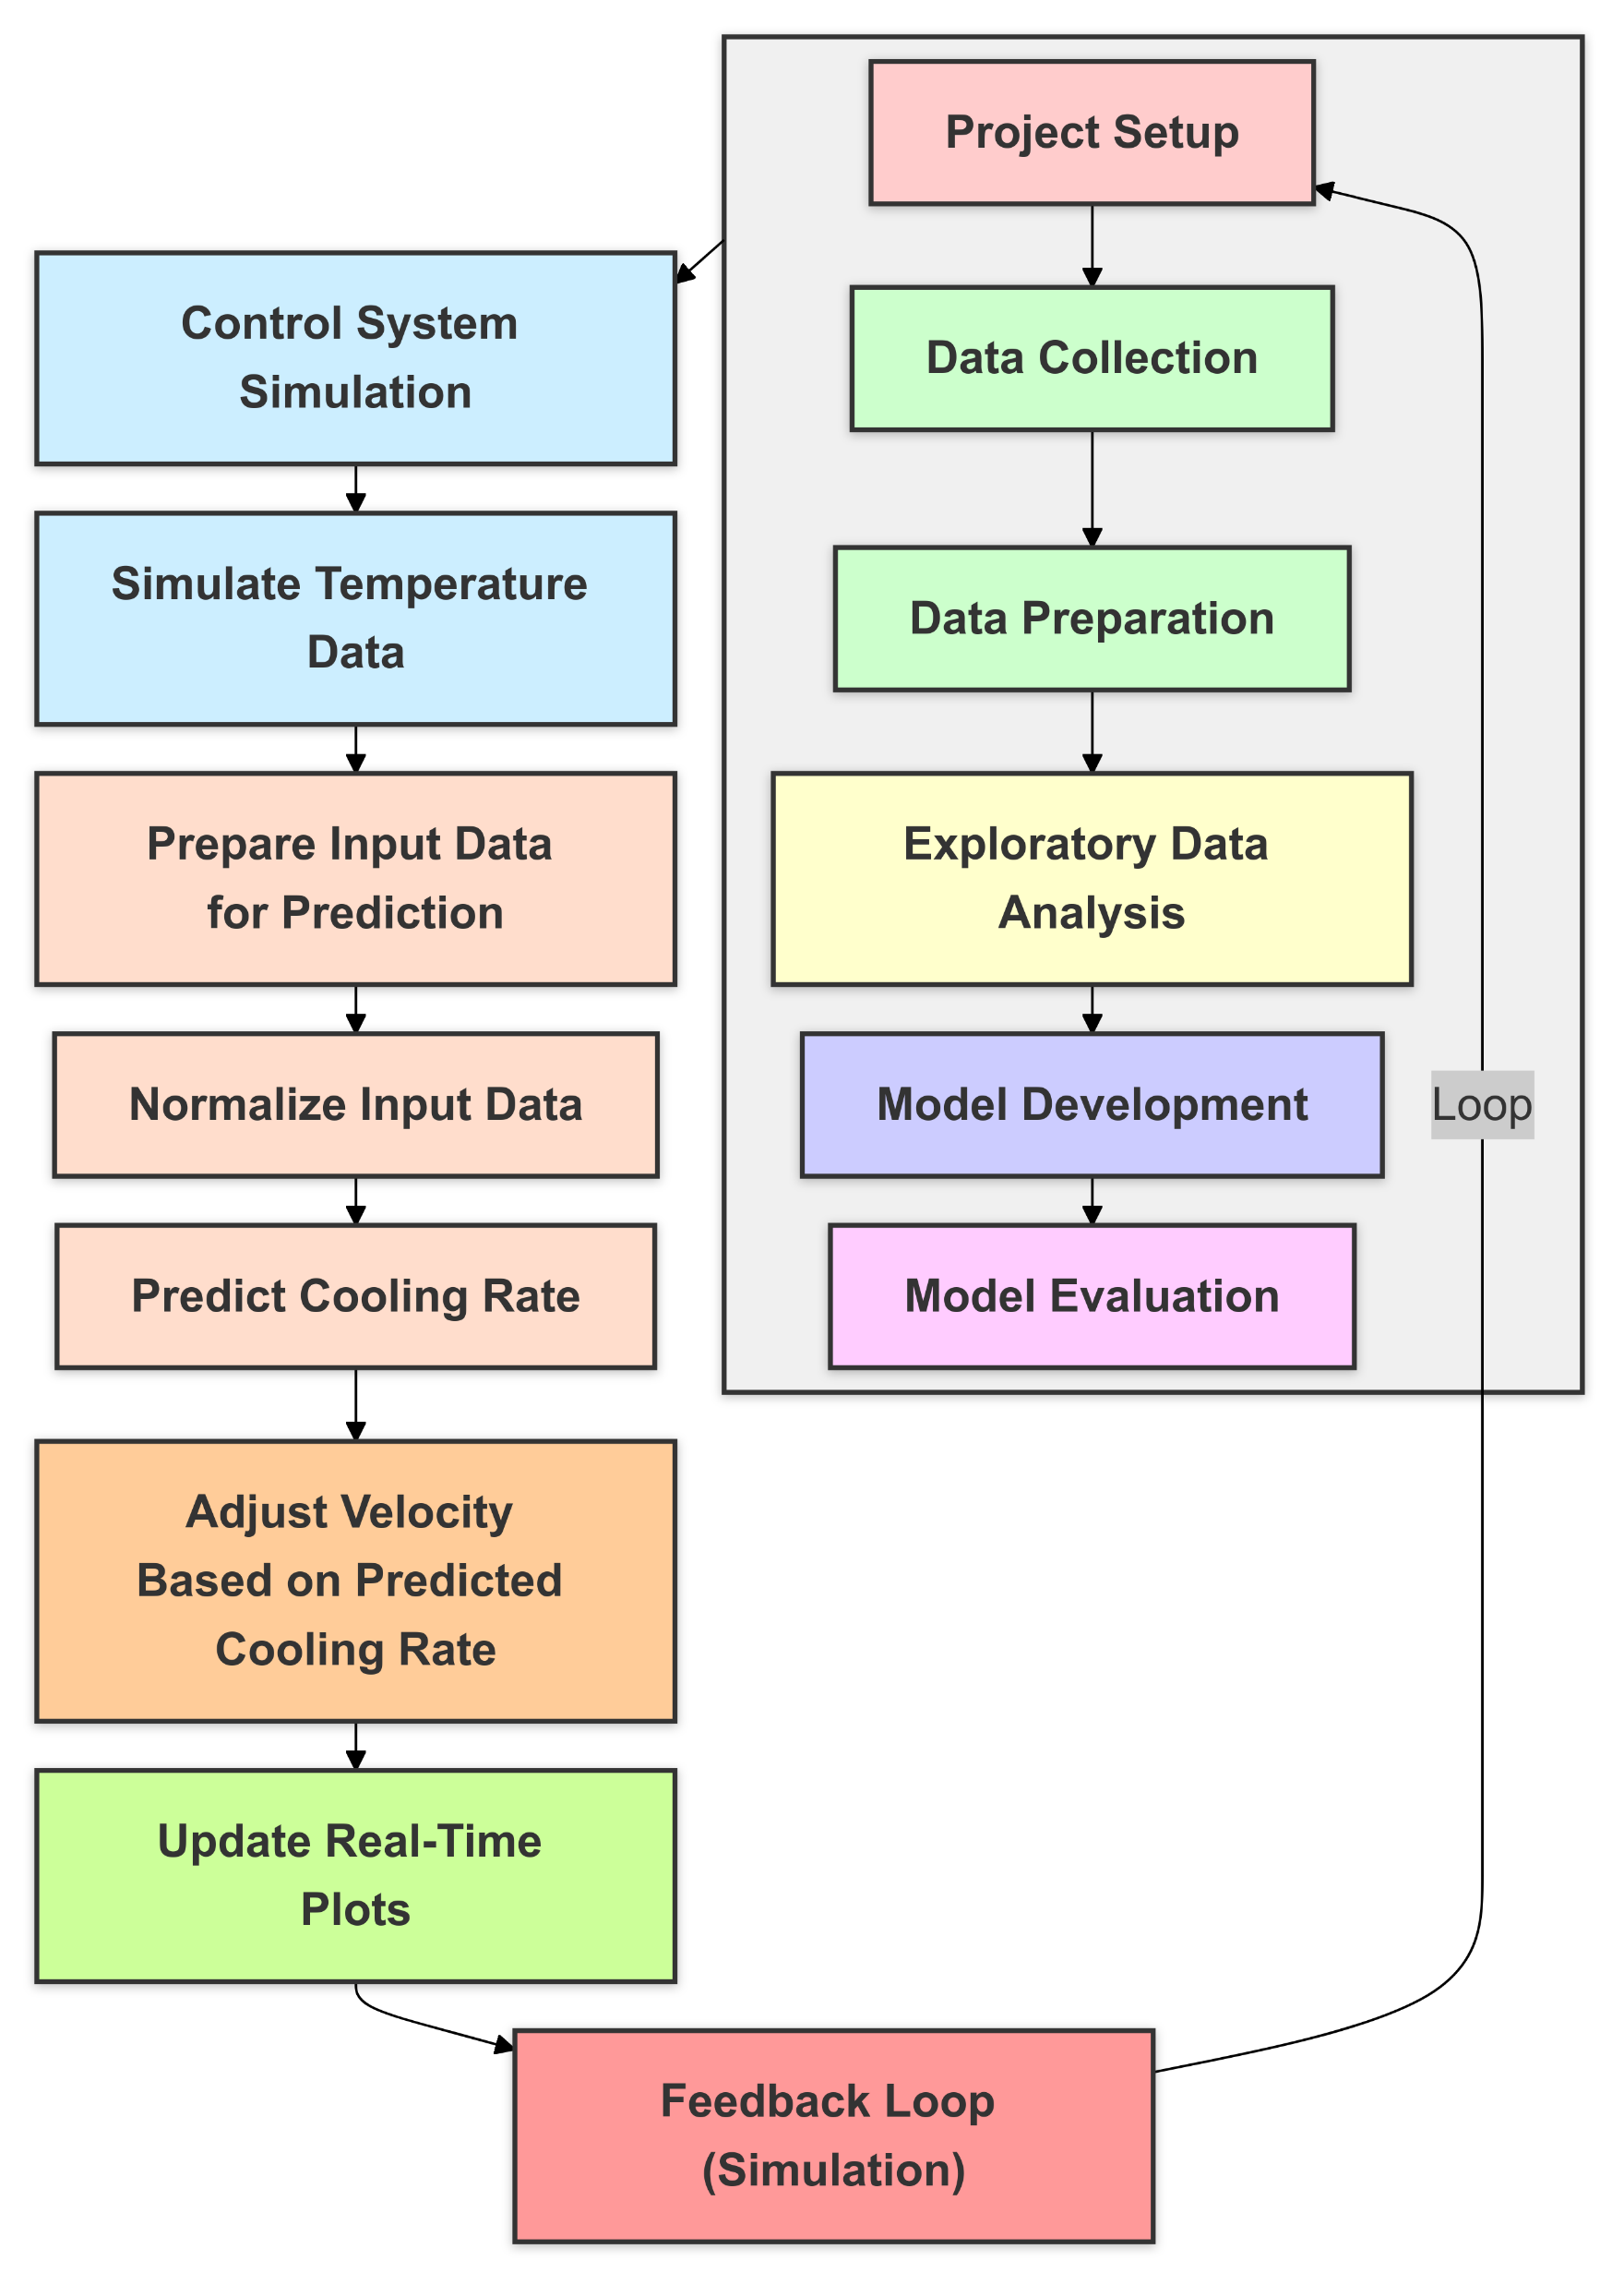
Model Development
ML Model
Simulation
Model

Slide 33
Model Development
Features | Cooling rate increase | Cooling rate decrease
Microstructure formation | Finer grains, potential segregation | Larger grains, improved homogeneity
Residual stress management | Higher stresses, higher risk of distortion and cracking | Lower stresses, reduced risk of distortion and cracking
Phase transformation control | Harder phases, higher strength, lower toughness | Softer phases, lower strength, higher ductility
Surface finish | Coarser finish, possible defects | Finer finish, reduced defects
Material consistency | Variable material properties | Consistent material properties
Process optimization | Needs advanced control | Simpler to manage

Slide 34
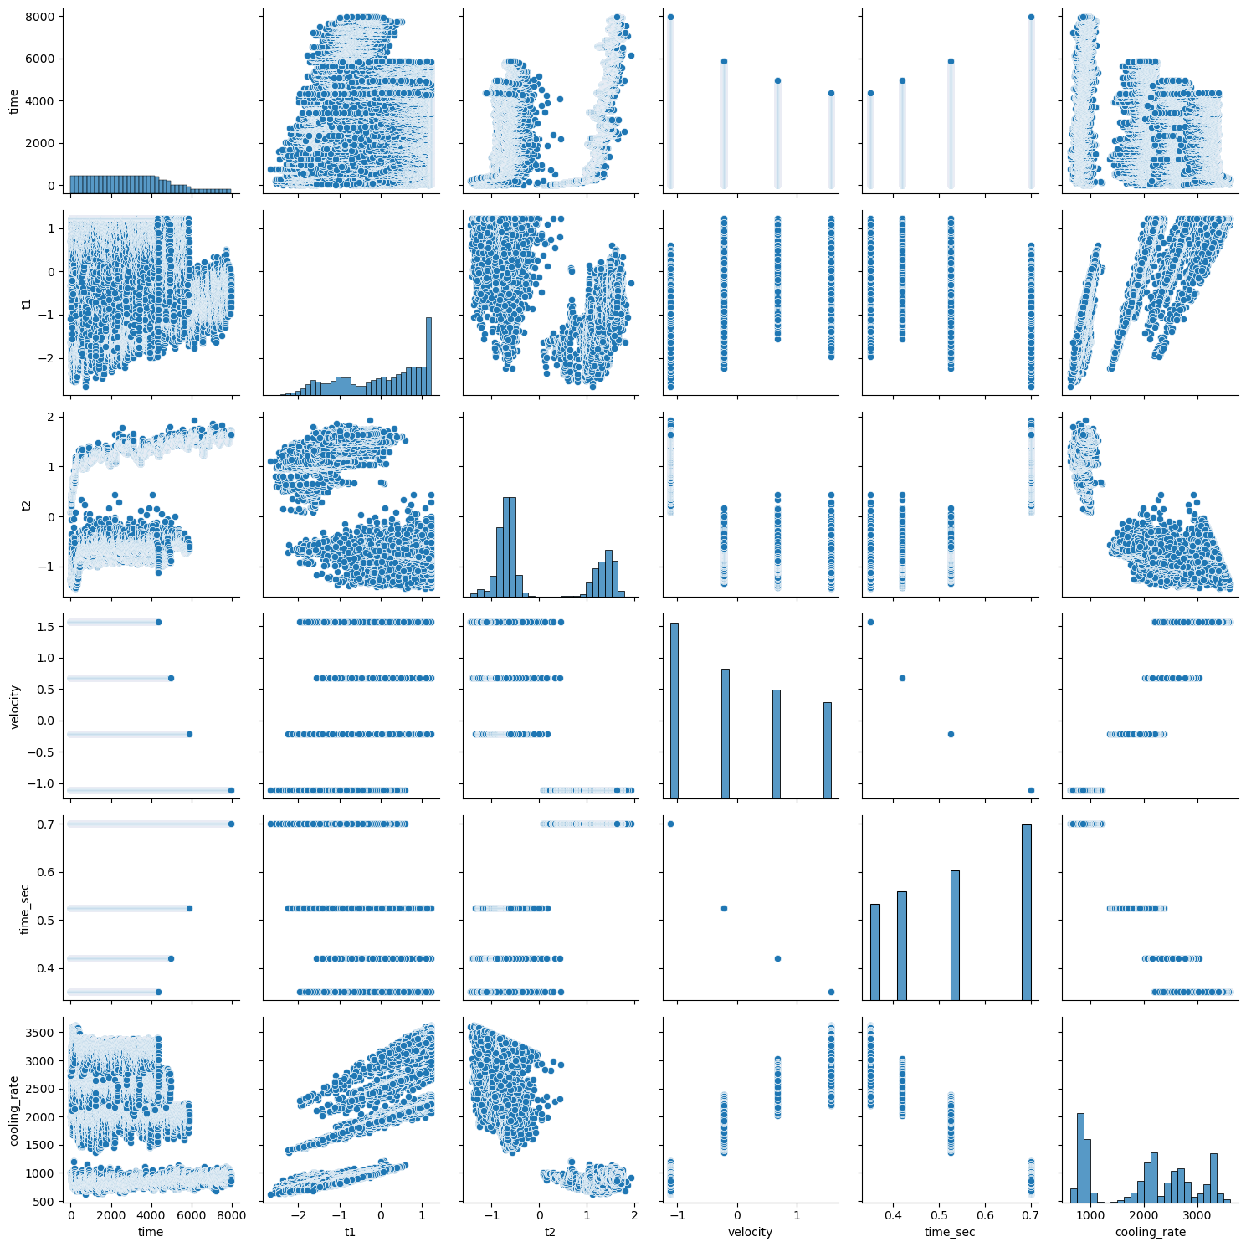
Exploratory Data Analysis
Exploratory Data Analysis (EDA) is a process used to analyze and understand data before applying statistical models or machine learning algorithms.
It involves:
Visualizing Data: Creating graphs and plots to see patterns and relationships.
Identifying Trends: Discovering patterns, correlations, and anomalies.
FIG 7: Exploratory Data Analysis Visualization

Slide 35
Model Evaluation
Mean Squared Error (MSE): 31.87
Indicates the average squared difference between actual and predicted values.
Lower value is equal to better accuracy.
Root Mean Squared Error (RMSE): 5.65
Square root of MSE.
Represents error in the same units as the target variable.
Lower value is equal to better accuracy.
R-squared (R²): 0.99996
Indicates the proportion of variance in the target variable explained by the model.
Value close to 1 is equal to excellent fit.
The model has high accuracy and explains almost all variability in the data.
Predictions are very close to actual values.

